Slide 1
Mastering Event Handling in React
Understanding Logic and Callbacks

Slide 2
What is an Event?
Definition: Any action triggered by a user on the webpage.
Common React Events:
onClick: Triggered by a mouse click.
onKeyDown: Triggered when a key is pressed.
onMouseOver: Triggered by hovering.
onSubmit: Triggered when a form is sent.
Mechanism: React listens to these events and triggers an Event Handler (a function).

Slide 3
The Golden Rule – Passing vs. Calling
Correct: onClick={handleClick}
  Analogy: Giving React your phone number so it can call you later.
Incorrect: onClick={handleClick()}
  Problem: This calls the function immediately during the render, not during the click.
Summary: Always pass the reference to the function, do not execute it with parentheses inside the JSX curly braces.

Slide 4
Handling Arguments with Callbacks
The Problem: You want to pass a specific message or ID to your function, e.g., handleClick('Hello').
The Solution: Use an Anonymous Arrow Function (Callback).
Why? The arrow function acts as a wrapper. React stores the arrow function and only runs the code inside it when the event occurs.
<button onClick={() => handleClick('Custom Message')}>
Click Me
</button>

Slide 5
Accessing the Event Object
React automatically passes an event object to your handler.
This is essential for:
Reading input values (event.target.value).
Detecting which key was pressed (event.key).
Preventing default browser behavior (event.preventDefault()).
function handleKeyDown(event) {
console.log(`Key pressed: ${event.key}`);
}

Slide 6
Practical Examples (Non-State)
The Random Color Change: Modifying document.body.style directly in the handler.
The Key Logger: Alerting the user when they type inside an input field.
Reusable Message Button: Using props to determine what message the event handler displays.

Slide 7
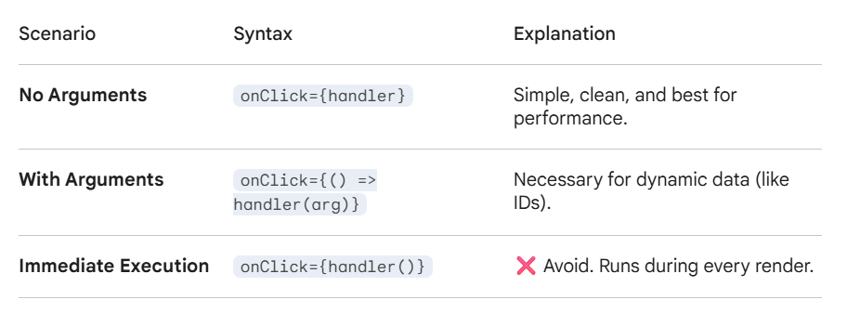
When to Use What

Slide 8
Summary
Events make your app interactive.
React uses a Synthetic Event system (wrapper around native browser events).
Use arrow function callbacks sparingly—only when arguments are required.
Understanding the difference between passing a function and calling it is what separates beginner from pro.

Slide 9
Knowledge Check
What is "Event Bubbling" and how do we stop it?
Can we pass multiple arguments to a handler?
Why does React use Synthetic Events instead of native ones?

